Slide 1
Systems Analysis and Design
Chapter 1
Introduction to Systems Analysis and Design

Slide 2
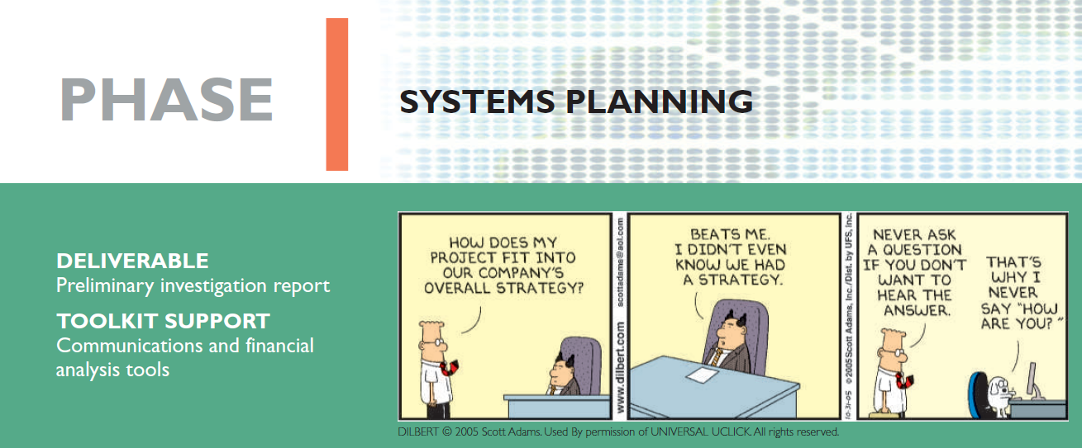
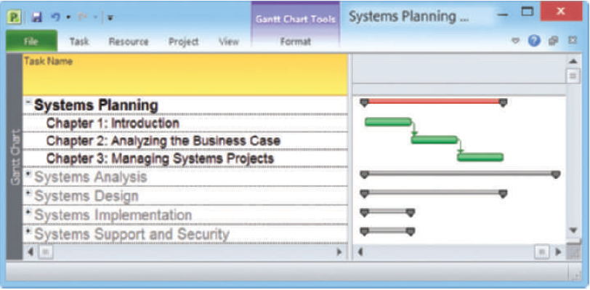

Systems Analysis and Design, 11th Edition
Scott Tilley and Harry Rosenblatt

Slide 3
Chapter Objectives
Describe the impact of information technology
Define systems analysis and design and the role of a systems analyst
Define an information system and describe its components
Explain how profiles and models can represent business functions and operations
Explain how the Internet has affected business strategies and relationships

Slide 4
Chapter Objectives (Cont.)
Identify various types of information systems and explain who uses them
Distinguish among structured analysis, object-oriented analysis, and agile methods
Explain the waterfall model, and how it has evolved

Slide 5
1.1 : The Role of Systems Analysis and Design
INFORMATION TECHNOLOGY
(IT)
SYSTEM ANALYSIS & DESIGN
(SAD)
Combination of software, hardware & services that people use to manage, access, communicate and share information.
Step-by-step process for developing high-quality information system.
Chapter 1: Intro. To Systems Analysis and Design
is a person that plans, develop and maintain IS
Combines IT, people & data to support business requirement.
INFORMATION SYSTEM
(IS)
SYSTEM ANALYST
(SA)

Slide 6
The Impact of Information Technology
Information Technology (IT)
  Combination of hardware and software products and services that companies use to manage, access, communicate, and share information
The Future of IT
  Will see robust growth for at least a decade
  The greatest need will be for systems analysts, network administrators, data communications analysts, and software engineers

Slide 7


The Impact of Information Technology
The Role of Systems Analysis and Design
  Systems Analysis and Design
    Step-by-step process for developing high-quality information systems
  Systems Analyst
    Plan, develop, and maintain information systems

Slide 8





The Impact of Information Technology
Who develops Information Systems?
  In-house applications
  Software packages
  Internet-based application services
  Outsourcing
  Custom solutions
  Enterprise-wide software strategies
  How versus What
Notes:
Traditionally
Developed inside company
(in-house development / in-house application) OR
Purchase system (software packages) from outside vendors.
Now / Today
Internet-based application services
Custom solution from an IT consultant
Outsourcing
To consider implementing IS, the company must :
has a clear set of objective by outlining its business needs & identifying possible IT solution
determine what the system supposed to do
decide how the system will be implemented

Slide 9
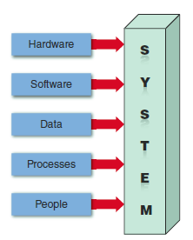
Information System Components
A system is a set of related
components that produces
specific results
Mission-critical systems are
vital to a company’s
operations
Information systems have
five key components:
hardware, software,
data, processes, and people
FIGURE 1-6 An information
system needs these components.

Slide 10
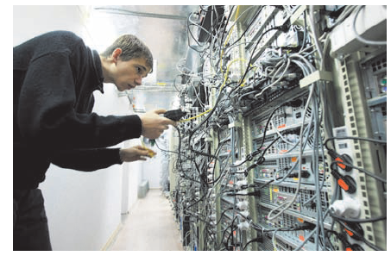
Information System Components (Cont.)
Hardware
  Is the physical layer of the information system
  Moore’s Law
Software
  System software
  Application software
    Horizontal system
    Vertical system
    Legacy systems
FIGURE 1-7 Server farms provide the enormous power and speed that modern IT systems need.

Slide 11
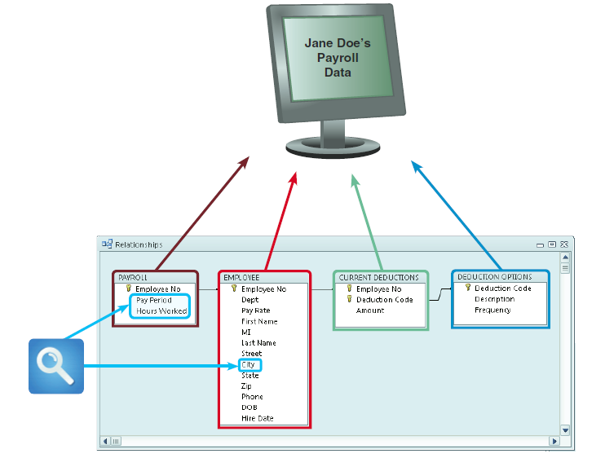
Information System Components
(Cont.)
Data
  Tables store data
  Linked tables work
  together to supply
  data
Processes
  Describe the tasks and
  business functions that
  users, managers, and IT
  staff members perform to
  achieve specific results
People
  Stakeholders
  Users or end users
FIGURE 1-8 In a typical payroll system, data is stored in separate tables that are linked to form an overall database.

Slide 12

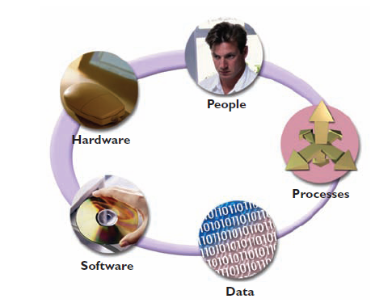
1.3 : Information System Components
Information System Components :
  Hardware
Data
Process
Software
Chapter 1: Intro. To Systems Analysis and Design
People
System software
App. software
Horizontal System
Vertical System

Slide 13
Hardware
Chapter 1: Intro. To Systems Analysis and Design
Figure: Multiple servers provide the power and speed that modern IT systems require.

Slide 14
Software
Software | Function | Example
System Software | Manages the hardware components | Operating system Security software Device drivers Utility programs (data backup and disk management) Network software
Application Software | Programs that support day-to-day business functions and provide users with the information they require | Enterprise applications (order processing systems, payroll systems, and company communications networks) Individual users (spreadsheets, word processors, and database management systems)
Horizontal System | Application software that can be adapted for use in many different types of companies | Inventory application Payroll application
Vertical System | Application software that is designed to meet the unique requirements of a specific business or industry | Retailer system Academic system
Legacy System | When planning an information system, a company must consider how a new system will interface with older systems (legacy systems). | A new human resources system might need to exchange data with an older payroll application

Slide 15
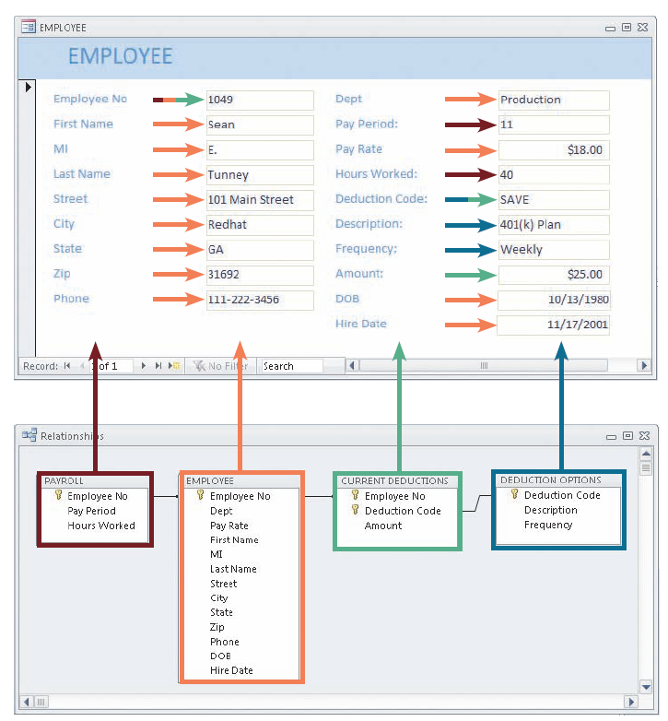
Data
Data is the raw material that an information system transforms into useful information.
An information system can store data in various locations, called tables.
By linking the tables, the system can extract specific information.
Users see an integrated form, which is their window into the payroll system
Chapter 1: Intro. To Systems Analysis and Design
Figure: A payroll system that stores data in four separate tables.

Slide 16
Processes
Processes describe the tasks and business functions that users, managers, and IT staff members perform to achieve specific results.
Processes represent actual day-to-day business operations.
Chapter 1: Intro. To Systems Analysis and Design
People
People who have an interest in an information system are called stakeholders.
The management, IT staffs, users (end users) – from inside and outside of the organization

Slide 17
Understanding The Business
Systems analysts use modeling to represent company operations and information needs. Business process modeling involves a business profile and a set of models that document business operations.

Slide 18
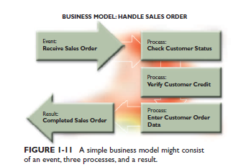
1.4 : Understanding the Business
IT professional / Sys. Analyst must well understand a company’s business operation…why?
Use process called business process modeling (BPM) to represent company’s operations & infor. needs
Chapter 1: Intro. To Systems Analysis and Design
Business Profile
Business Process

Slide 19
Understanding The Business
  Business Profile - describe company overall function
    overview of a company’s mission, functions, organization, products, services, customers, suppliers, competitors, constraints, and future direction.
    a systems analyst usually needs to do additional research and fact-finding
    a business profile is the starting point for the modeling process.

Slide 20
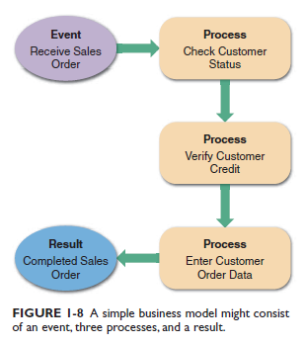
Understanding The Business
  Business Processes - a specific set of transactions, events, and results that can be described and documented
    A business process model (BPM)
    graphically displays one or more
    business processes, such as
    handling an airline reservation,
    filling a product order, or
    updating a customer account

Slide 21
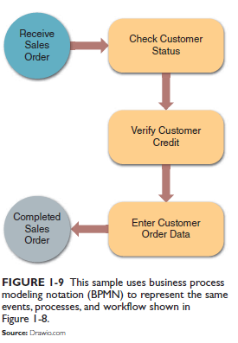
Understanding The Business
    Business Process Modeling Notation (BPMN)
    Computer-based tools for complex models that includes standard shapes and symbols to represent events, processes, workflows, and more.
    Multipurpose application such as Microsoft Visio, CASE tools such as Visible Analyst, or online diagramming tools such as draw.io can be used to create BPMN models.

Slide 22
Understanding The Business
New Kinds of Companies
  Product-oriented
    routers, microchips
  Service-oriented
    resellers and providers of information
  Brick-and-mortar
    conduct business from physical locations (have premises)
  Dot-com (.com) or Internet-dependent
    Amazon.com, Google, eBay, Yahoo!

Slide 23
Impact of the Internet
E-Commerce or I-Commerce
B2C (Business-to-Consumer)
B2B (Business-to-Business)
  EDI
  Extensible markup language (XML)
  Supplier relationship management (SRM)

Slide 24

Impact of the Internet
Web-Based System Development
  WebSphere
  .NET
  Web services
  Internet-based systems involve various hardware and software designs

Slide 25
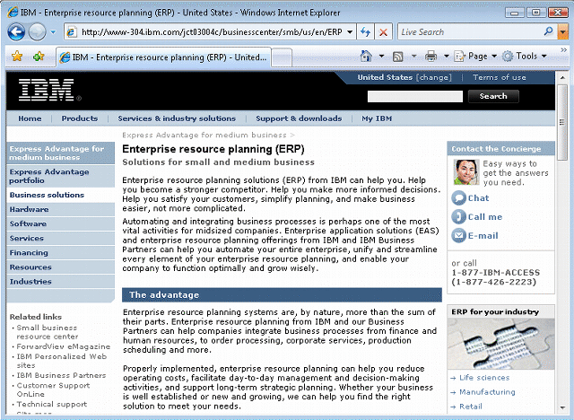
How Business Uses Information Systems
Enterprise computing systems
  Support company-wide operations and data management requirements
  Enterprise resource planning (ERP)
  Many hardware and software vendors target the enterprise computing market

Slide 26
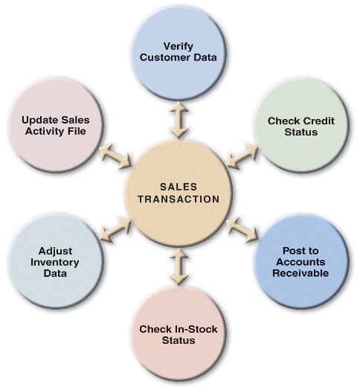


How Business Uses Information Systems
Transaction processing systems
  Involve large amounts of data and are mission-critical systems
  Efficient because they process a set of transaction-related commands as a group rather than individually

Slide 27
How Business Uses Information Systems
Business support systems
  Provide job-related information to users at all levels of a company
  Management information systems (MIS)
  Radio frequency identification (RFID)
  What-if

Slide 28

How Business Uses Information Systems
Knowledge management systems
  Called expert systems
  Simulate human reasoning by combining a knowledge base and inference rules
  Many knowledge management systems use a technique called fuzzy logic

Slide 29

How Business Uses Information Systems
User productivity systems
  Technology that improves productivity
  Groupware
Information systems integration
  Most large companies require systems that combine transaction processing, business support, knowledge management, and user productivity features

Slide 30
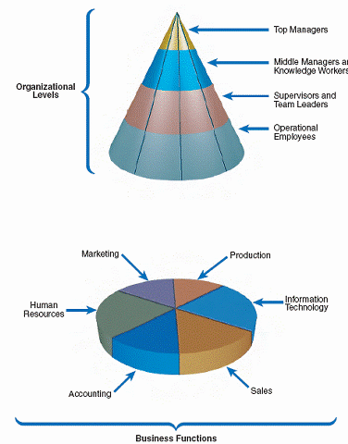
Information System Users and Their Needs

Slide 31
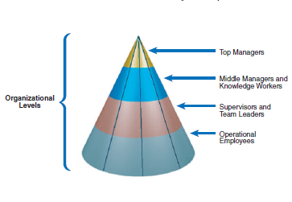
1.5 : Organizational Structure / level
develop long range plans (strategic plan), which define the company mission & goal
Provide direction, necessary resources & feedback to supervisor
provide support for the organization’s
basic functions
-include professional staff members such as systems analysts, programmers, accountants, researchers, trainers, and human resource specialists
Chapter 1: Intro. To Systems Analysis and Design
who directly produce goods and services for a business
oversee operational employees and carry out
day-to-day functions.

Slide 32

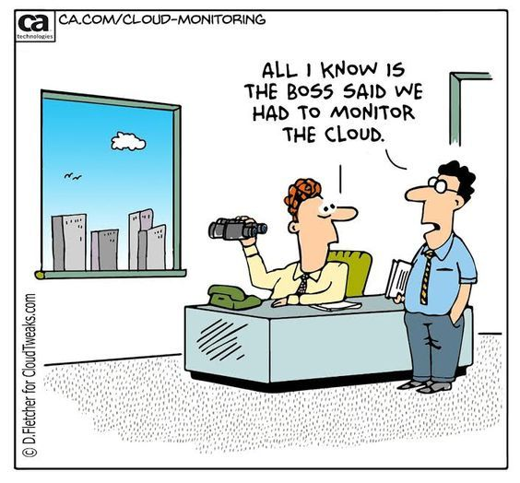
IT DEPARTMENT

Slide 33
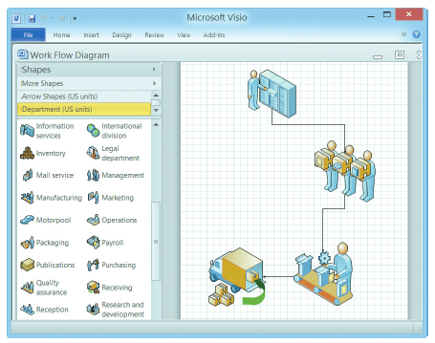

Systems Development Tools
Modeling
  Business model
  Requirements model
  Data model
  Object model
  Network model
  Process model
FIGURE 1-21 Microsoft Visio allows you to drag and drop various symbols and connect them to show a business process.

Slide 34
1.6 : Systems Development Tools & Techniques
  What is Modeling ?
    Graphical representation of a concept or process that system developers can analyze, test and modify
    Used to describe and simplify an information system
Chapter 1: Intro. To Systems Analysis and Design

Slide 35
1.6 : Systems Development Tools & Techniques
MODELING REPRESENTATION
DATA MODEL
OBJECT MODEL
describes the information that a system must provide
BUSINESS MODEL
describes the data structure and design
NETWORK MODEL
PROCESS MODEL
describes objects, which combines data and processes
describes the design and protocols of telecommunication links
describes the logic that a programmer use in writing the program

Slide 36
1.6 : Systems Development Tools & Techniques
Modeling
Data Model
Process Model
Chapter 1: Intro. To Systems Analysis and Design
Input
Output
Object Model

Slide 37
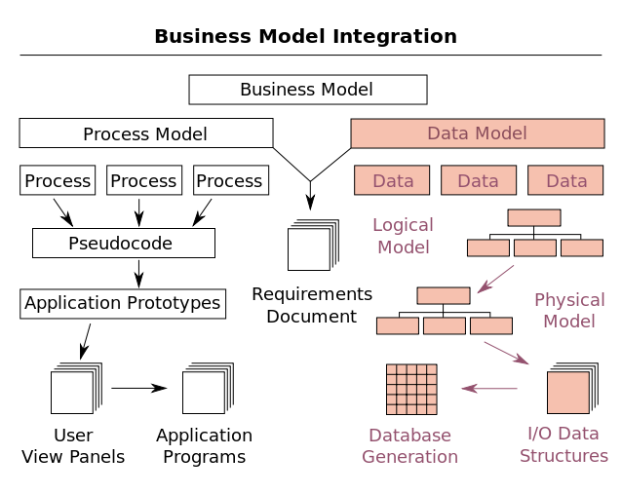
Example of Model Integration
Chapter 1: Intro. To Systems Analysis and Design
Source:
https://en.wikipedia.org/wiki/Data_model

Slide 38

Systems Development Tools (Cont.)
Prototyping
  Early working version of an information system
  Speeds up the development process significantly
  Important decisions might be made too early, before business or IT issues are thoroughly understood
  A prototype based on careful fact-fiing and modeling techniques can be an extremely valuable tool

Slide 39
Systems Development Tools (Cont.)
Computer-Aided Systems Engineering (CASE) Tools
  Provide an overall framework for systems development and support a wide variety of design methodologies such as:
    Structured analysis
    Object-oriented analysis
  Can generate program code, which speeds the implementation process

Slide 40
Systems Development Methods
Structured Analysis
  Traditional method for developing systems
  Organized into phases
Object-Oriented Analysis
  More recent method for developing systems
  Objects represent actual people, things, or events
Agile/Adaptive Methods
  Latest trend in software development
  Team-based effort broken down into cycles

Slide 41
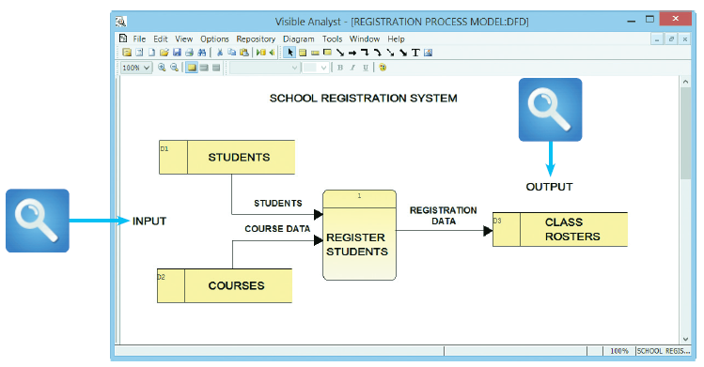
Systems Development Methods (Cont.)
Structured Analysis
  Time-tested and easy to understand
  Uses phases called the systems development life cycle (SDLC)
  Predictive approach
  Uses process
  models to
  describe a
  system
  graphically
FIGURE 1-24 This Visible Analyst screen shows a process model for a school registration system. The REGISTER STUDENTS process accepts input data from two sources and transforms it into output data.

Slide 42
Structured Analysis
Structured analysis uses a series of phases, called the systems development life cycle (SDLC).
Used to plan, analyze, design, implement, and support an information system.
Process-centered technique (processes that transform data into useful information)
Uses process model to describe a system graphically – DFD.
Typically uses Waterfall model.
  The result of each phase in Waterfall model is called a deliverable, or end product, which flows into the next phase.

Slide 43
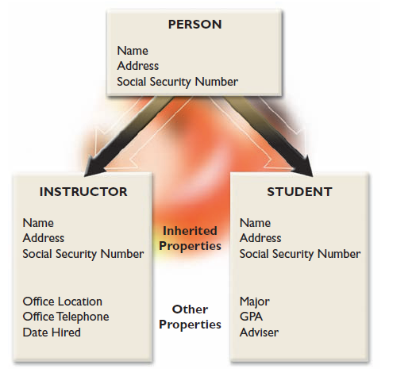
Object-Oriented Analysis
  Views the system in terms of data objects that combine data and processes.
  O-O phases tend to be more interactive compared to structured analysis.
  Pros: integrates easily with o-o programming languages & easy to maintain and expand.
  Cons: (newer) less familiar to development team & interaction of object can be complex in larger system
Figure: The PERSON class includes INSTRUCTOR and STUDENT objects, which have their own properties and inherited properties.

Slide 44
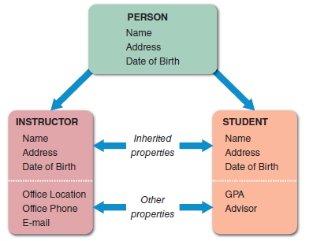
Systems Development Methods (Cont.)
Object-Oriented Analysis
    Combines data and the processes that act on the data into things called objects
    Objects are members of a
    class, which is a collection
    of similar objects
    Built-in processes,
    called methods, can
    change an object’s
    properties
    O-O methodology
    provides easy transition
    to O-O programming
    languages like Java
FIGURE 1-26 The PERSON class includes INSTRUCTOR and STUDENT objects, which have their own properties and inherited
properties.

Slide 45
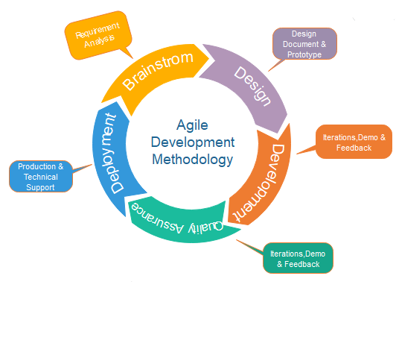
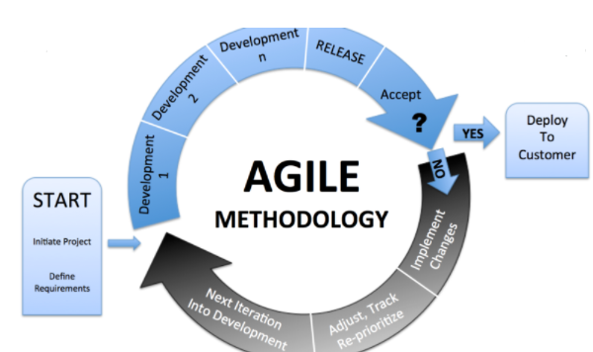
Agile Methods
  Agile methods attempt to develop a system incrementally, by building a series of prototypes and constantly adjusting them to user requirements.
  Agile methods typically use a spiral model, which represents a series of iterations, or revisions, based on user feedback.
  Pros: very flexible & efficient with changes. Stresses team interaction.
  Cons: need high level of technical & communication skills. Lack of structure & documentation-risk factor

Slide 46
Systems Development Methods (Cont.)
Agile Methods
    Newest development technique as systems are developed incrementally
    A series of prototypes are built and adjusted to meet user requirements
    As the process continues, developers revise, extend, and merge earlier versions into the final product
    Agile method emphasizes continuous feedback
      Iterative development
  Agile community has published the Agile Manifesto
  Spiral model

Slide 47
Systems Development Methods (Cont.)
Agile Methods
  Agile process determines the end result
  Other adaptive variations and related methods exist
  Two examples are Scrum and Extreme Programming (XP)
  Analysts should understand the pros and cons of any approach before selecting a development method

Slide 48
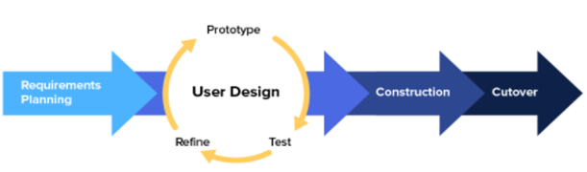
Joint Application Development (JAD)
  Uses team-based approach.
  Focuses on fact-finding, which is only one phase of the development process.
Rapid Application Development (RAD)
  Uses team-based approach.
  A compressed version of the entire development process.

Slide 49
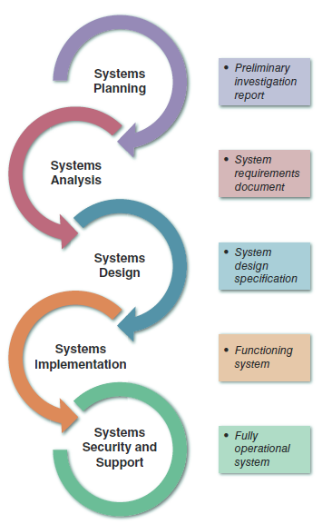









Systems Development Methods (Cont.)
  The SDLC model usually includes five steps
    Systems Planning
    Systems Analysis
    Systems Design
    Systems Implementation
    Systems Security and
    Support
FIGURE 1-25 Development phases and deliverables are
shown in the waterfall model.
The circular symbols indicate
interaction among the phases.

Slide 50
Systems Development Methods (Cont.)
Systems Planning
    Systems request – begins the process and describes problems or desired changes
    Purpose of this phase is to perform a preliminary investigation – a critical step
    Key part of preliminary investigation is a feasibility study

Slide 51
Systems Development Methods (Cont.)
Systems Analysis
    Build a logical model of the new system
    Perform fact-finding techniques
    Build business models, data and process models, and object models
    Deliverable is the system requirements document

Slide 52
Systems Development Methods (Cont.)
Systems Design
    Create a physical model that satisfies all documented requirements
    Design user interface
    Identify outputs, inputs, and processes
    Deliverable is the system design specification
    Management and user involvement is critical

Slide 53
Systems Development Methods (Cont.)
Systems Implementation
    New system is constructed
    Programs are written and tested
    System is installed
    Deliverable is a completely functioning and documented information system
Systems Support and Security
    A well-designed system must be secure, reliable, maintainable, and scalable
    Most information systems need to be updated significantly or replaced after several years of operation

Slide 54
Systems Development Methods (Cont.)
Other Development Methods
        Teams consists of IT staff, users, and managers
    joint application development (JAD)
      Focuses on team-based fact-finding
    Rapid application development (RAD)
      A compressed version of the entire development process

Slide 55
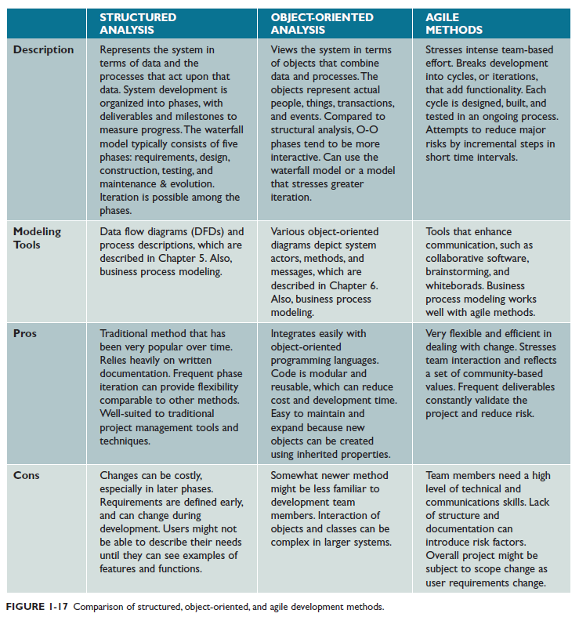

Slide 56

Systems Development Guidelines
Develop a project plan
Involve users and listen carefully to them
Use project management tools to identify tasks and milestones
Develop accurate cost and benefit information
Remain flexible

Slide 57
1. 9 : Information Technology Department
Director
Information Technology
Chapter 1: Intro. To Systems Analysis and Design
App. Development
User Support
Web Support
Sys. Support & Security
Dtbs Administration
Network Administration
Quality Assuarance (QA)

Slide 58

1. 10 : System Analyst Position
Responsibilities
  Investigates, Analyzes, Design, Develop, Install, Evaluates, Maintain
  Interact with user & manager within & outside company
  SA task overlap business & technical aspect
  Building business profile
  Review business process
  Select hardware & software
  Design IS
  Training users
  Plan & develop schedule of the project
  Estimate cost
  Conduct meeting
  Deliver presentation
  Write memos, reports & documentation
Chapter 1: Intro. To Systems Analysis and Design

Slide 59
1. 10 : System Analyst Position
Required skills
  Technical knowledge
  Strong oral & written comm. skill
  Good analytical ability
  Background of CS/MIS/CE
  Good interpersonal skill to interact with people at all level (from operational staff, managers, vendor, customer)
  Leadership & team building skill
Chapter 1: Intro. To Systems Analysis and Design

Slide 60

1. 10 : System Analyst Position
Certification
  Degree
  Master
Career Opportunity
  Government sector
  Private sector
Chapter 1: Intro. To Systems Analysis and Design

Slide 61
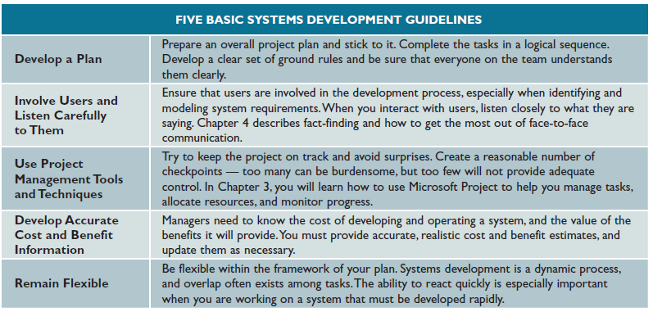
1. 11 : System Development Guidelines
Chapter 1: Intro. To Systems Analysis and Design

Slide 62
Mapping Course Topic with SDLC
WEEK | TOPIC | SDLC PHASE
1-2 | 1.0 Introduction to Systems Analysis and Design | Systems Planning
3-4 | 2.0 Analyzing the Business Case
5-6 | 3.0 Requirements Modeling | Systems Analysis
7-8 | 4.0 Enterprise Modeling
9 | 5.0 Development Strategies
10 | 6.0 Data Design | Systems Design
11 | 7.0 User Interface, Input, & Output Design
12 | 8.0 Systems Implementation | Systems Implementation
13 | 9.0 Systems Operation & Support | Systems Support & Security

Slide 63
Chapter Summary
IT refers to the combination of hardware and software resources that companies use to manage, access, communicate, and share information
The essential components of an information system are hardware, software, data, processes, and people

Slide 64
Chapter Summary (Cont.)
Information systems are identified as enterprise computing systems, transaction processing systems, business support systems, knowledge management systems, or user productivity systems
Organization structure includes top managers, middle managers and knowledge workers, supervisors and team leaders

Slide 65
Chapter Summary
Systems analyst use modeling, prototyping, and computer aided systems engineering (CASE) tools
Three popular system development approaches are structured analysis, object-oriented analysis (O-O), and agile methods, also called adaptive methods
Regardless of the development strategy, people, tasks, timetables, and cost must be managed effectively using project management tools

